Slide 1

Project Title –Seasonal Agricultural Performance
Shubhy Agarwal
Bennett University
AICTE STU ID : STU6a2a80aa6a75e1781170346

Slide 2

PROBLEM STATEMENT
Agricultural activities are influenced by seasonal variations in environmental conditions, farming practices, resource availability and market conditions. As a result, agricultural performance may differ from one season to another. However, raw agricultural data does not clearly explain how agricultural performance changes across seasons or what patterns can be observed in different seasonal conditions. The problem is to analyze the given agricultural dataset and investigate seasonal differences in agricultural performance by identifying meaningful patterns, trends, relationships and variations within the available data.

Slide 3
Project Description This project focuses on analyzing agricultural performance across different seasons using a dataset containing 4,000 farm-level records and 28 variables. The analysis examines factors such as crop production, yield, rainfall, temperature, soil conditions, resource usage, and economic performance. Python and Pandas were used to explore and analyze the dataset, while seasonal and crop-wise comparisons were performed to identify important patterns and variations. Correlation analysis was also used to examine relationships between environmental, resource-related, and agricultural performance factors. The analysis aims to understand how agricultural performance varies across seasons and provide meaningful insights that can support better agricultural planning and decision-making.

Slide 4

WHO ARE THE END USERS?
The end users of this project include farmers and farm managers, agricultural planners, agribusiness organizations, researchers, and policymakers. The insights from the analysis can help them understand seasonal agricultural performance, make better decisions about crop planning and resource usage, and improve overall farm management.

Slide 5

Technology Used
Python, Pandas, Numpy and Google Colab

Slide 6
RESULTS Kharif season recorded the highest average yield compared with Rabi and Zaid. Kharif also had the highest average profit and total production. Kharif received the highest average rainfall and had the highest average soil moisture. Zaid had the highest average temperature, sunlight duration, and water usage. Temperature showed almost no linear relationship with yield in the dataset. Pest risk also showed a very weak relationship with yield.

Slide 7
RESULTS
[Add screen shots of your code ]

Slide 8
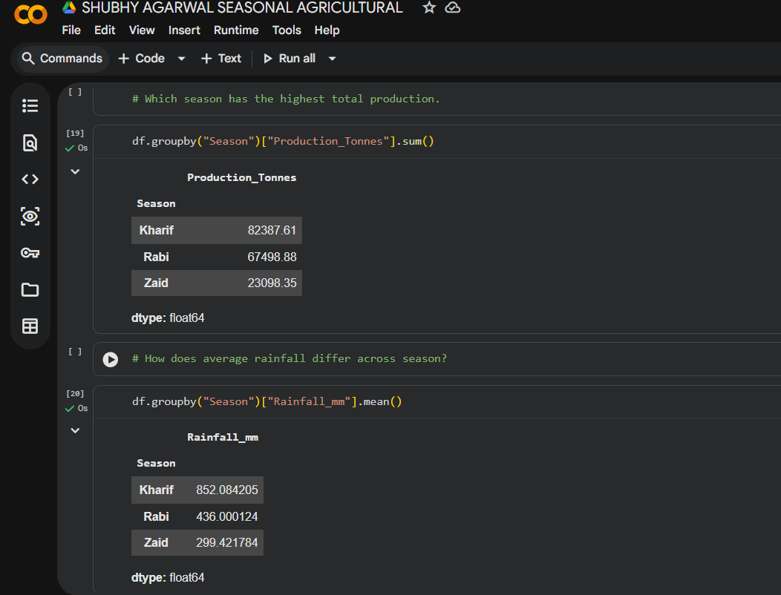
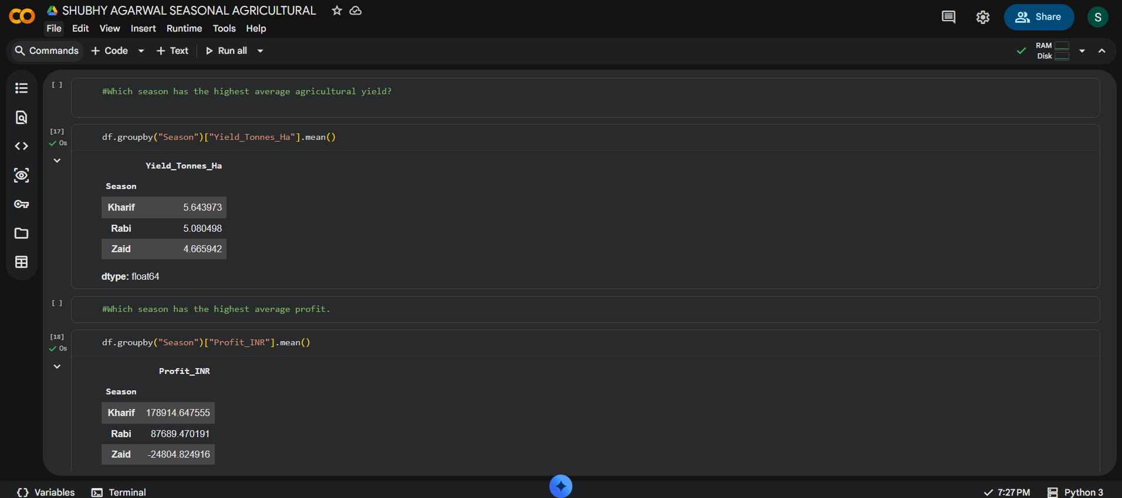
RESULTS

Slide 9
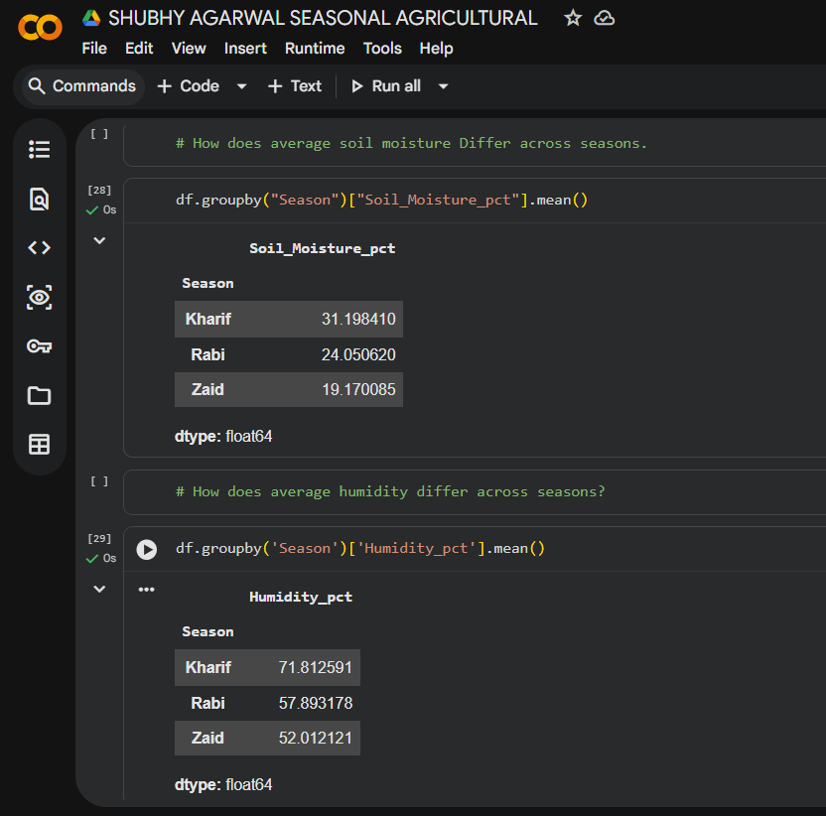
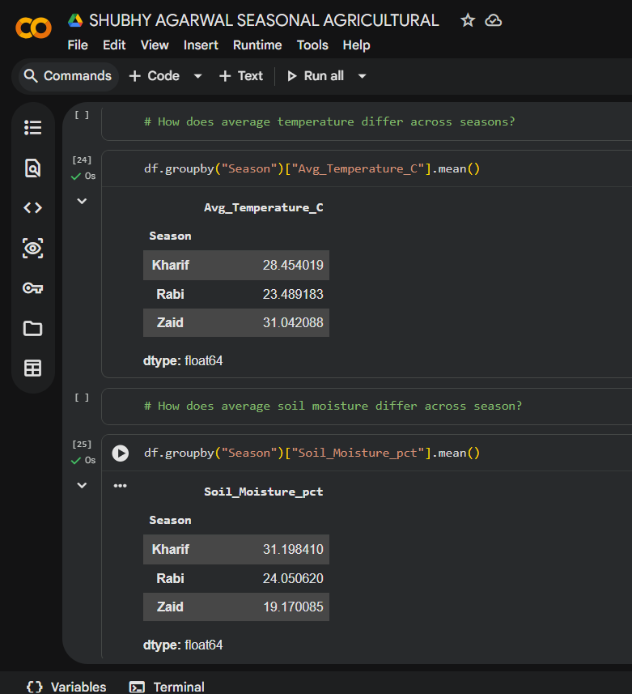
RESULTS
[Add screen shots of your code ]

Slide 10
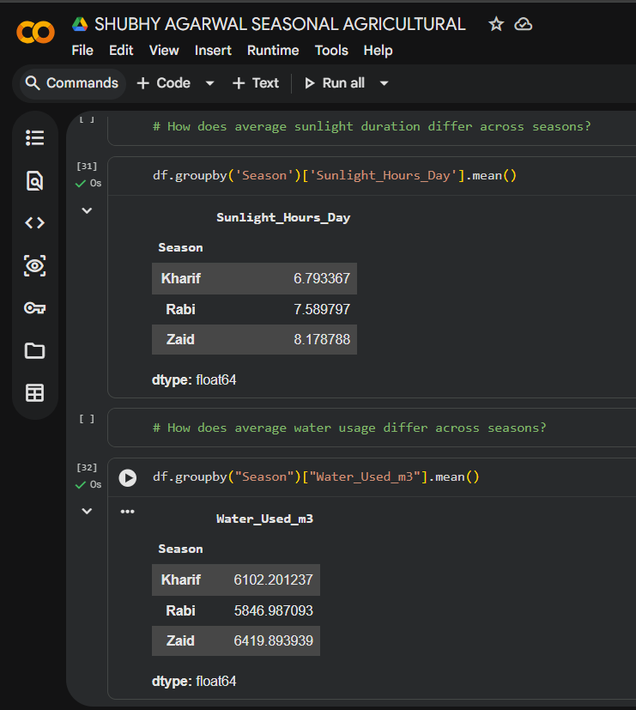
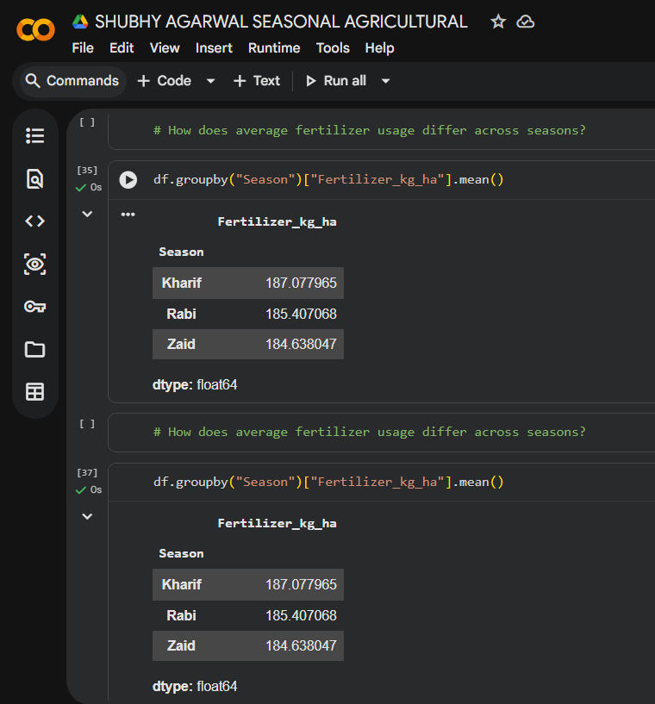
RESULTS
[Add screen shots of your code ]

Slide 11
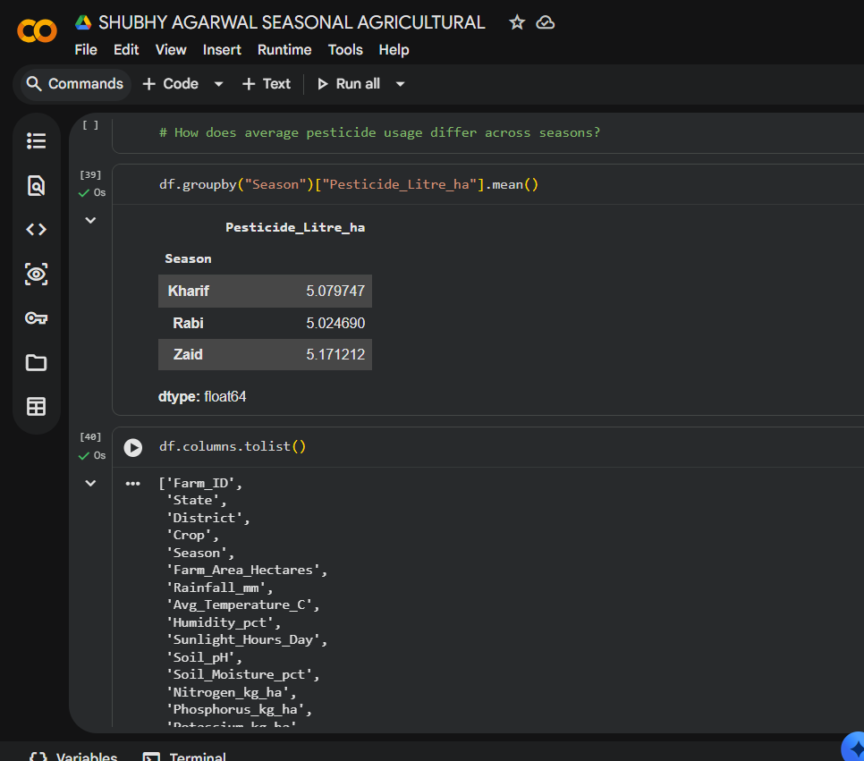
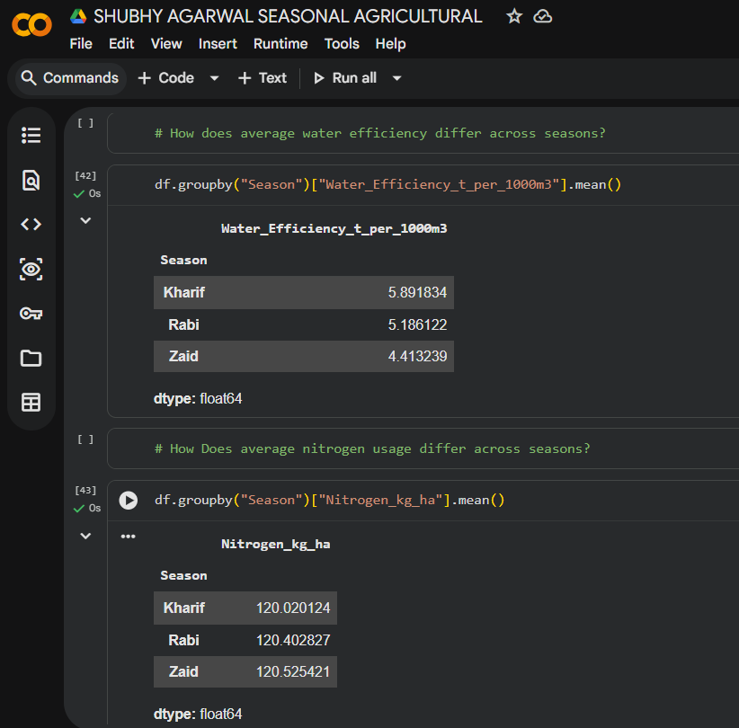
RESULTS
[Add screen shots of your code ]

Slide 12
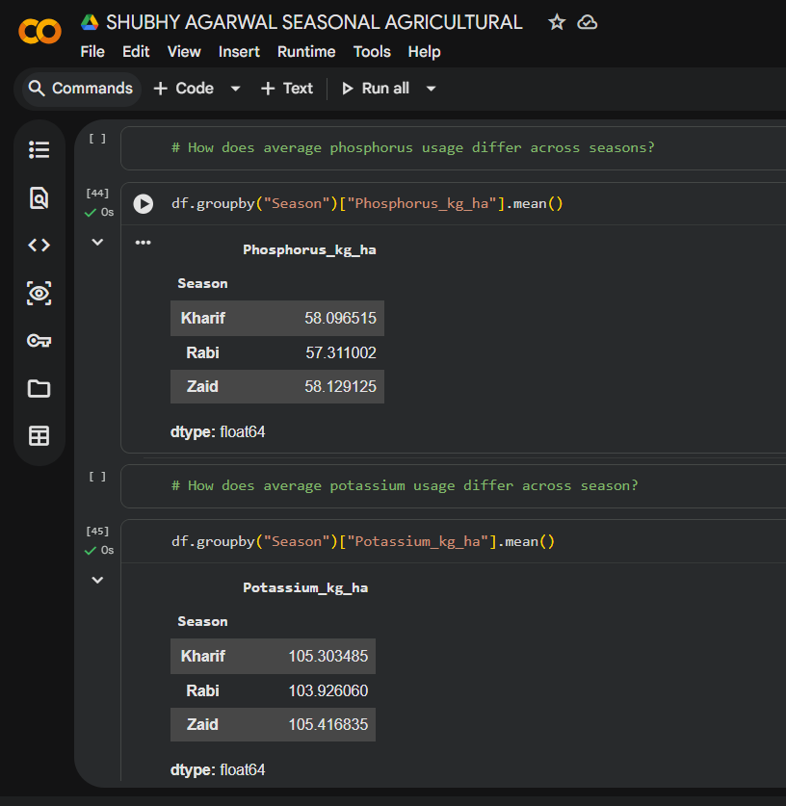
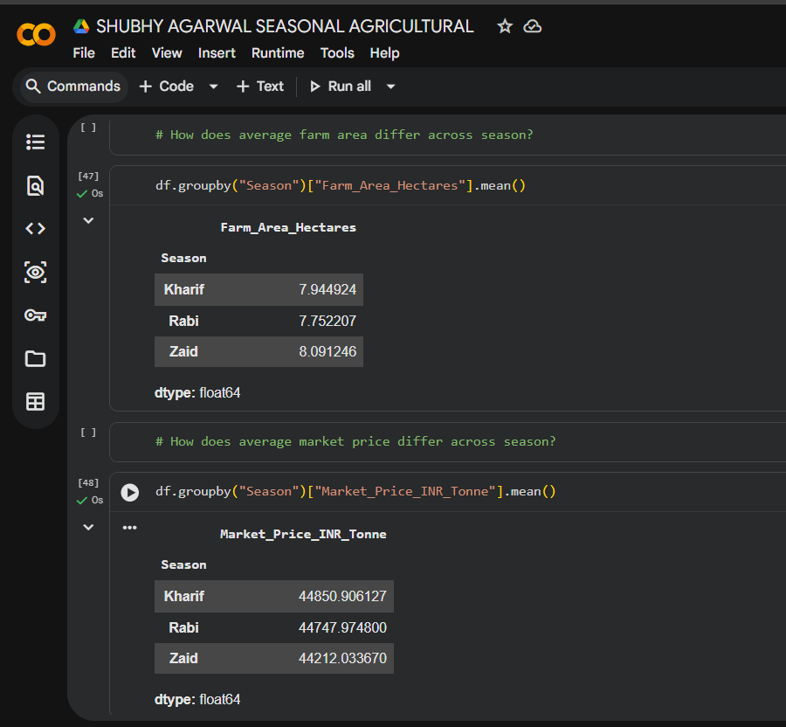
RESULTS
[Add screen shots of your code ]

Slide 13
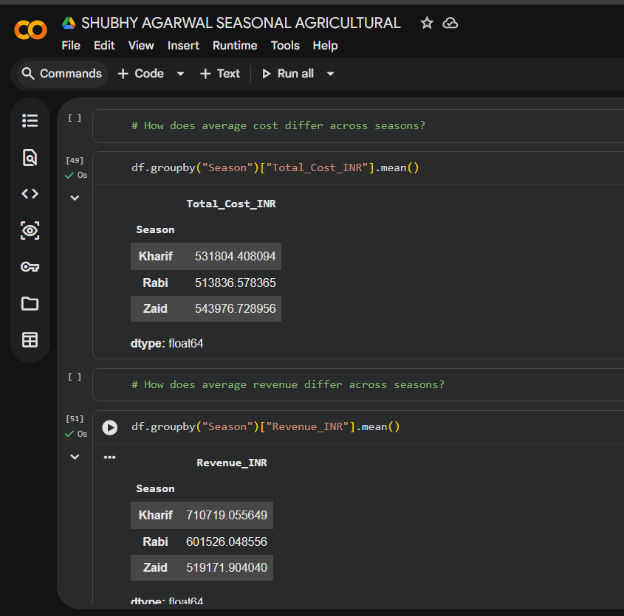
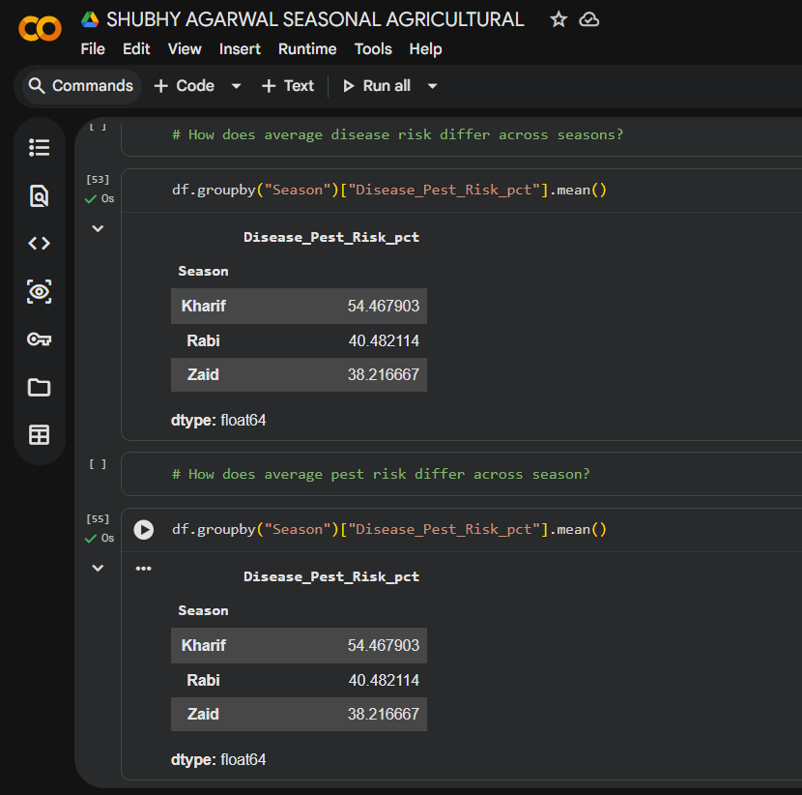
RESULTS
[Add screen shots of your code ]

Slide 14
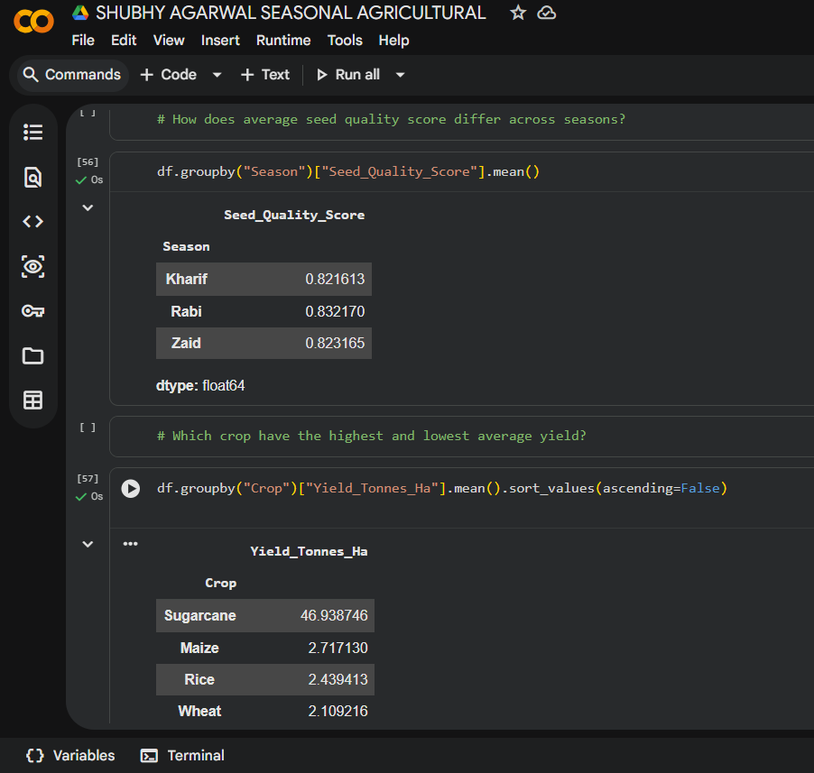
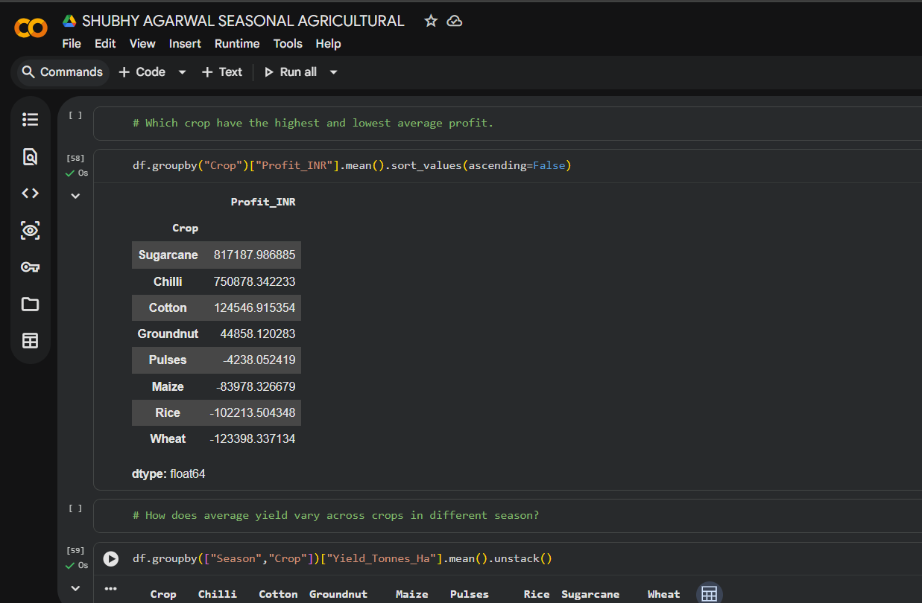
RESULTS
[Add screen shots of your code ]

Slide 15
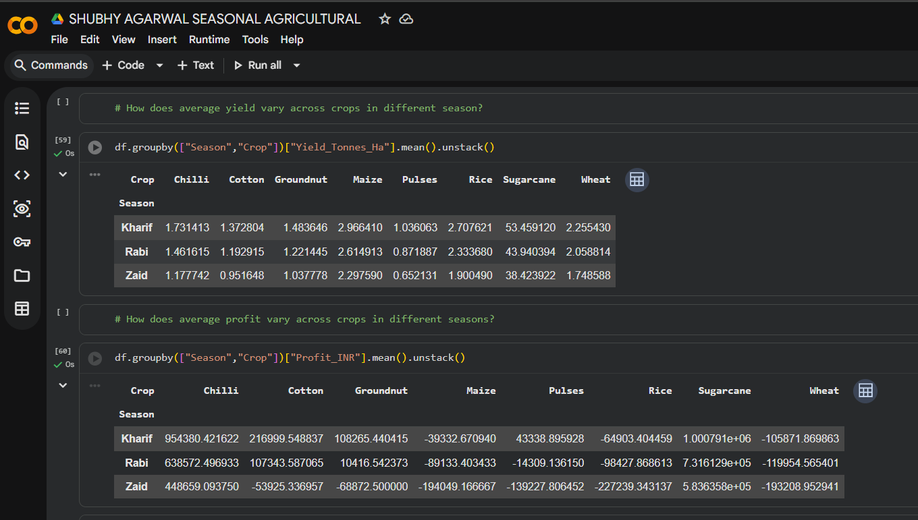
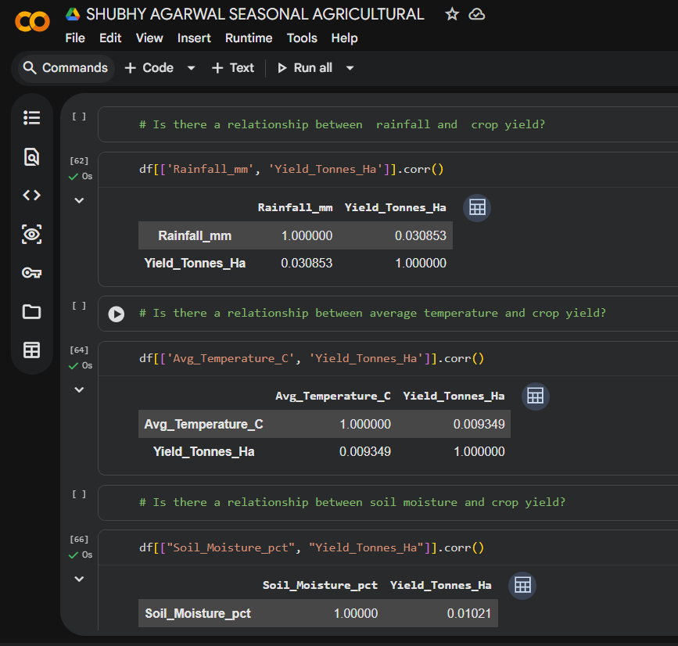
RESULTS
[Add screen shots of your code ]

Slide 16
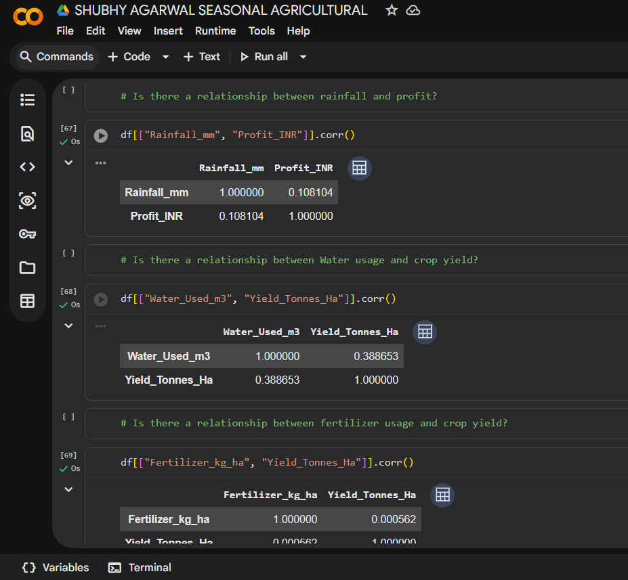
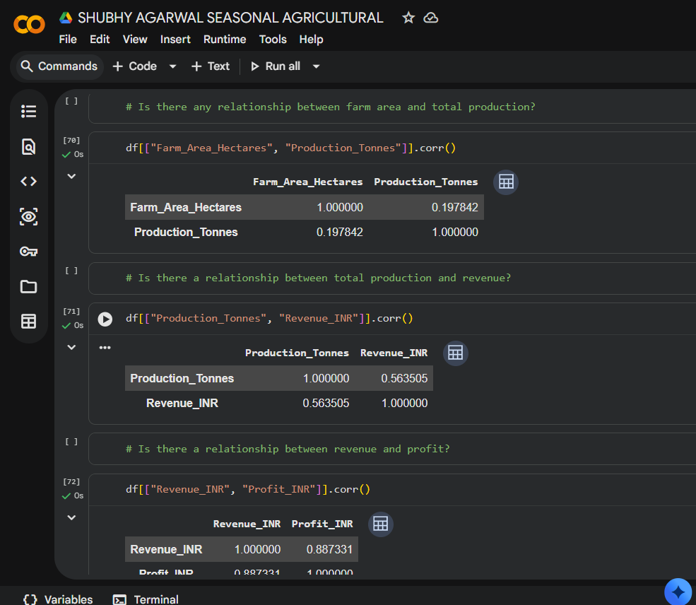
RESULTS
[Add screen shots of your code ]

Slide 17
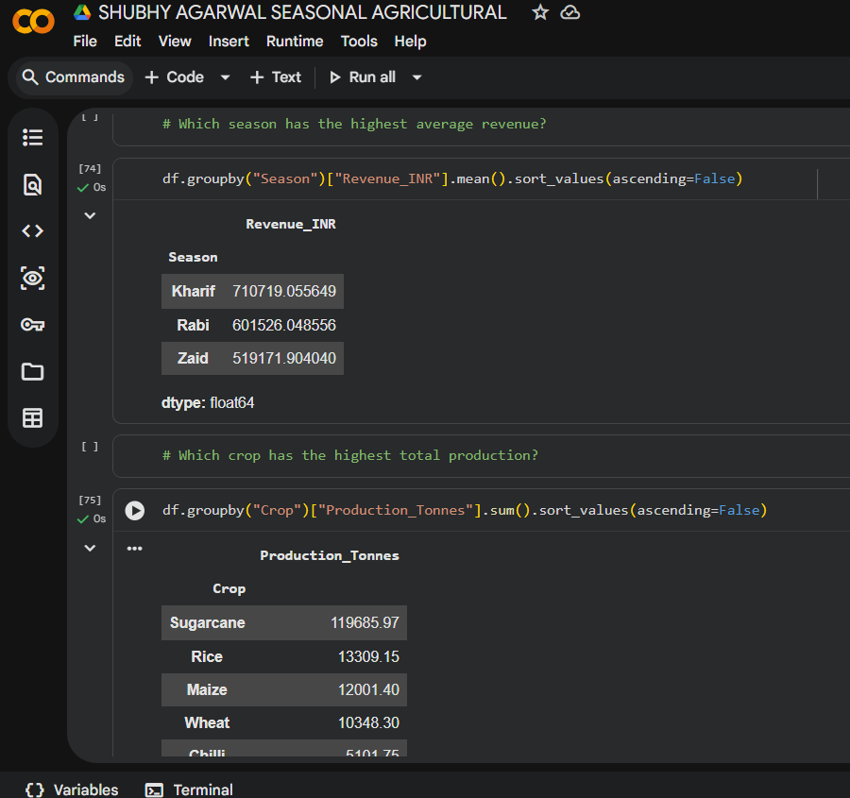
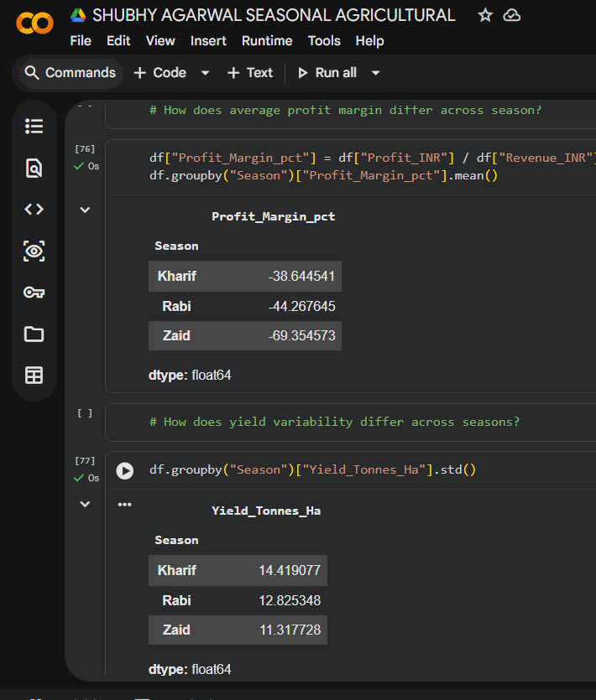
RESULTS
[Add screen shots of your code ]

Slide 18
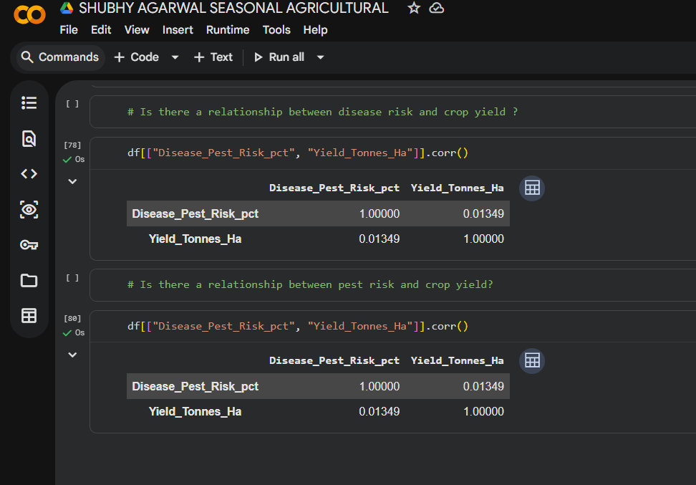
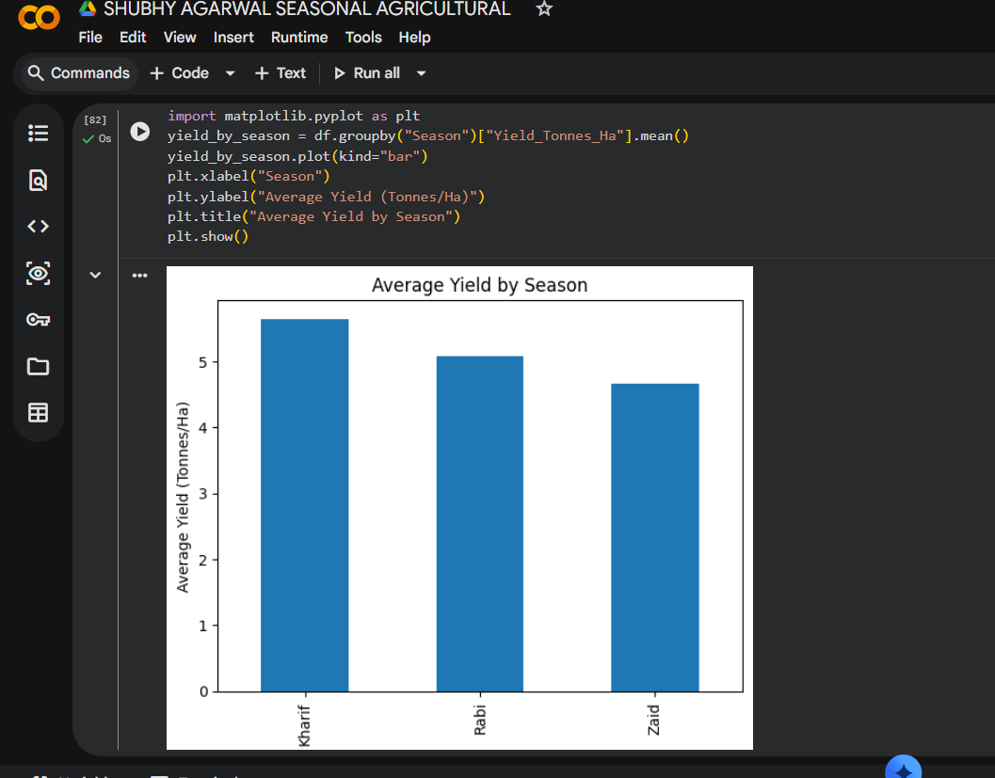
RESULTS
[Add screen shots of your code ]

Slide 19
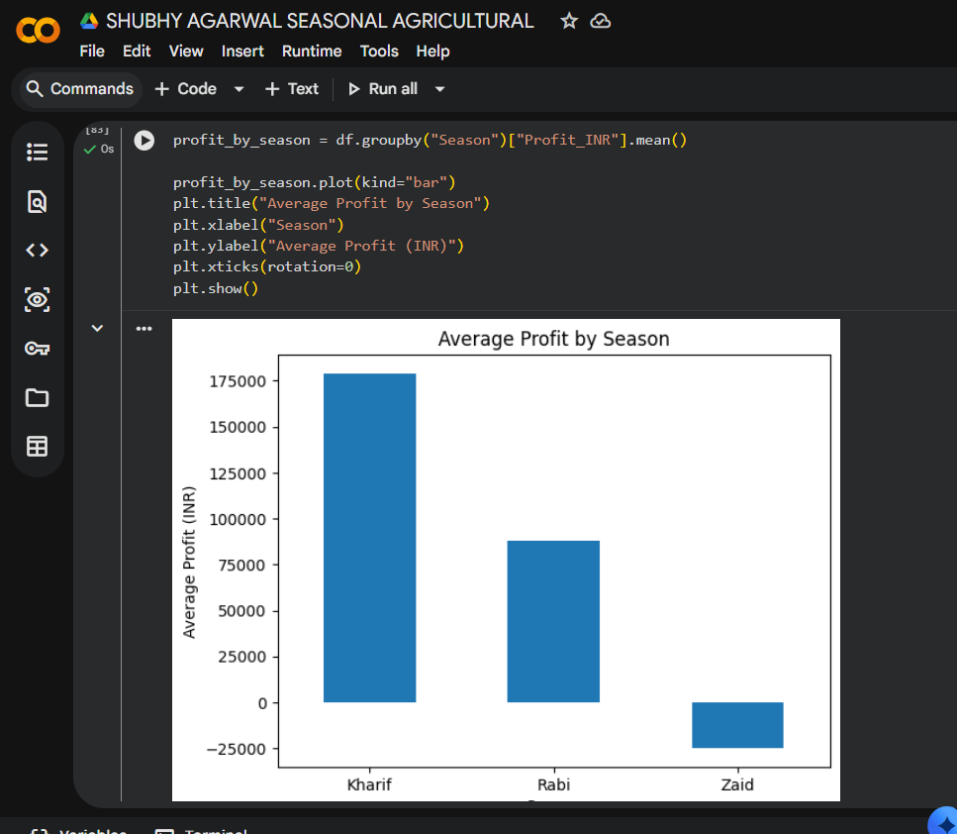
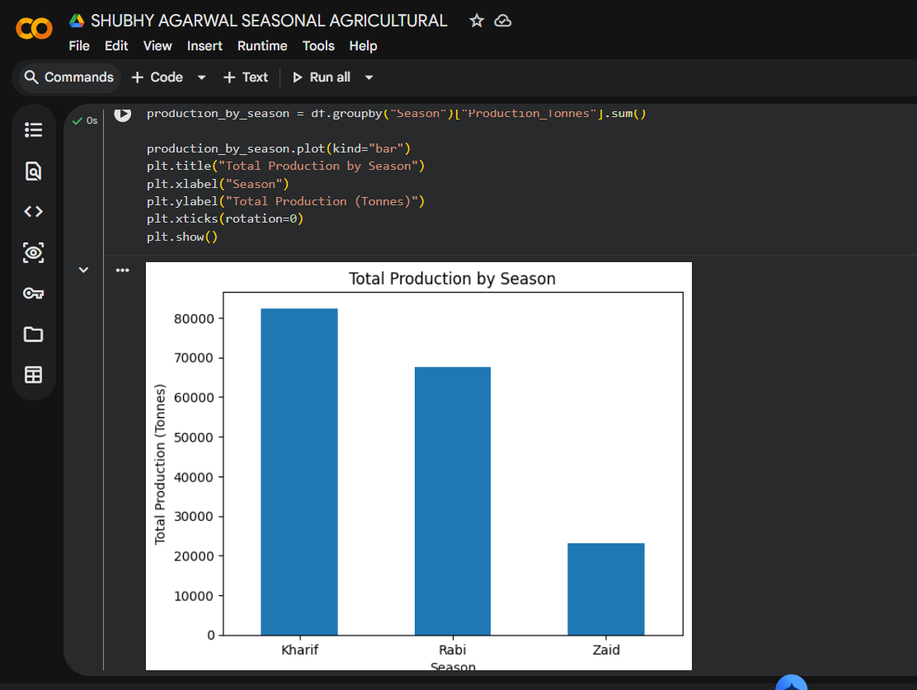
RESULTS
[Add screen shots of your code ]

Slide 20
Future scope Develop predictive models to forecast crop yield and profit. Integrate real-time weather and market-price data for better decision-making. Build a crop recommendation system based on seasonal and environmental conditions. Optimize water, fertilizer, and pesticide usage for efficient resource management. Extend the analysis with geographical/region-wise data to identify location-specific agricultural patterns.

Slide 21
GitHub Link
https://github.com/shubhyagarwal/Seasonal_Agriculture_Performance_Analysis

Slide 22
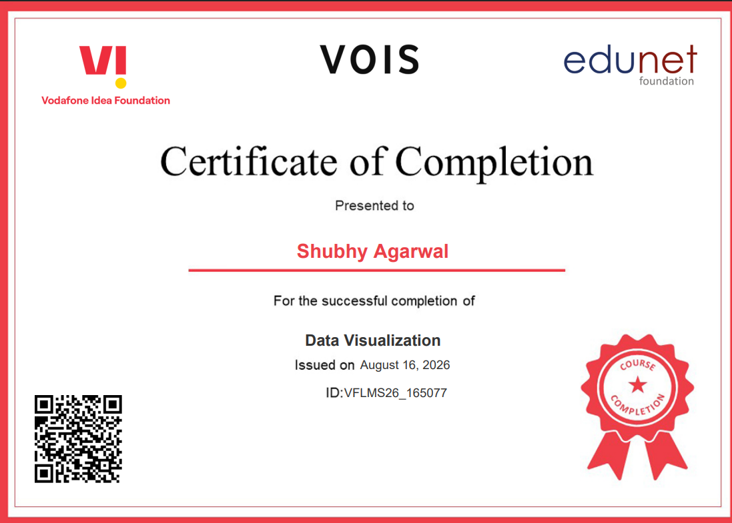
VOIS Course completion certificate - Course name- Data Visualization

Slide 23
Thank you
.
.

